Slide 1

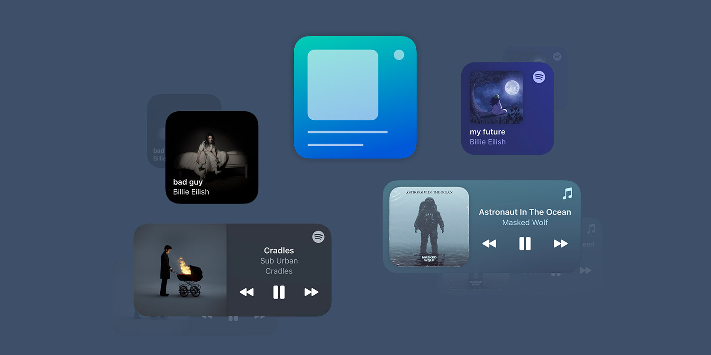
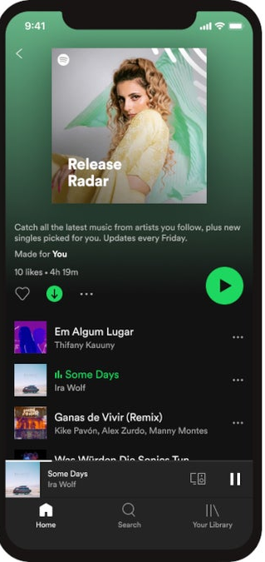
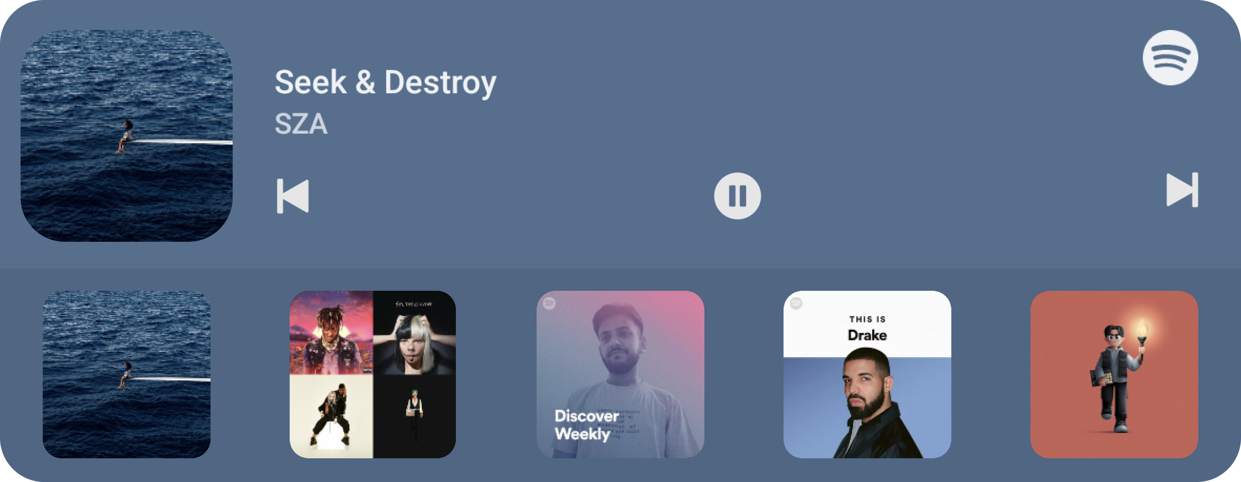

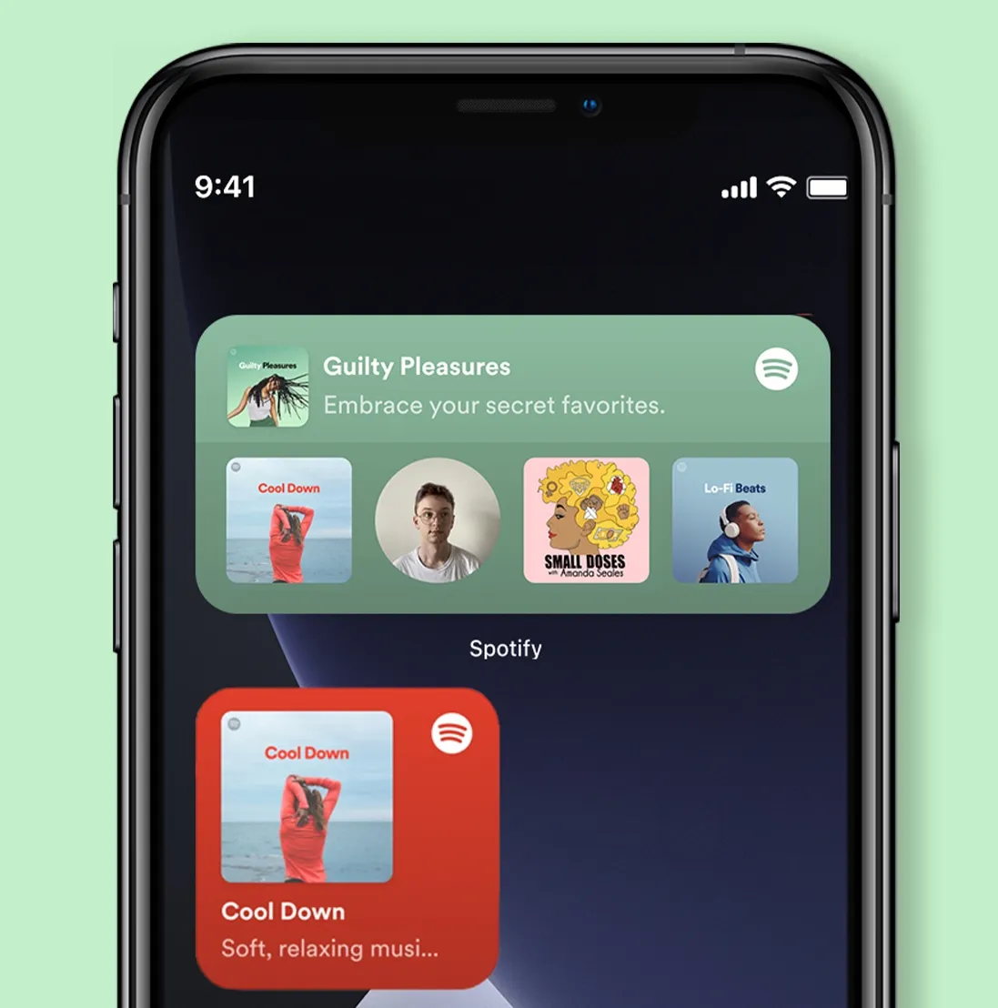
Spotify
Social Media Analysis
Hannah Wilkinson
IMC – 541 – 900
Week 3 Writing Assignment
Professor Neal Stewart
September 8, 2025

Slide 2
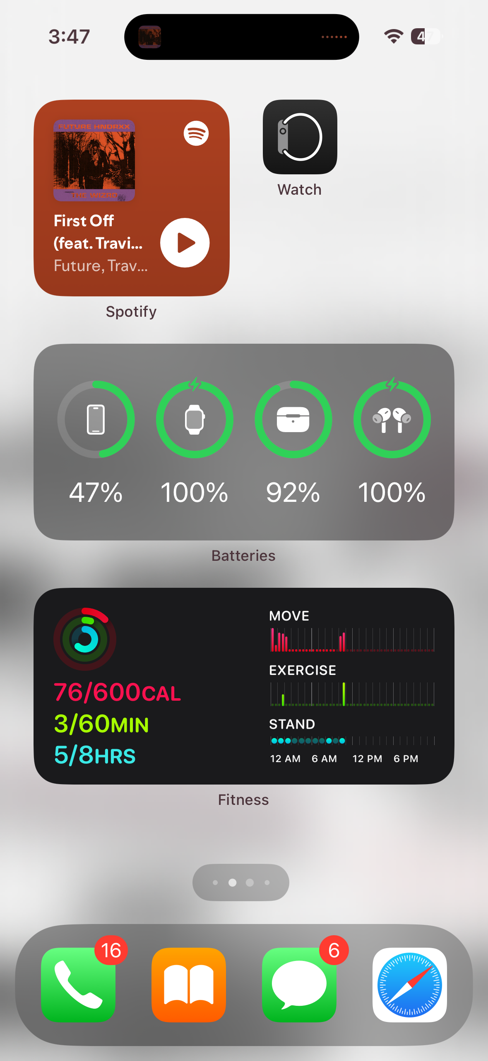
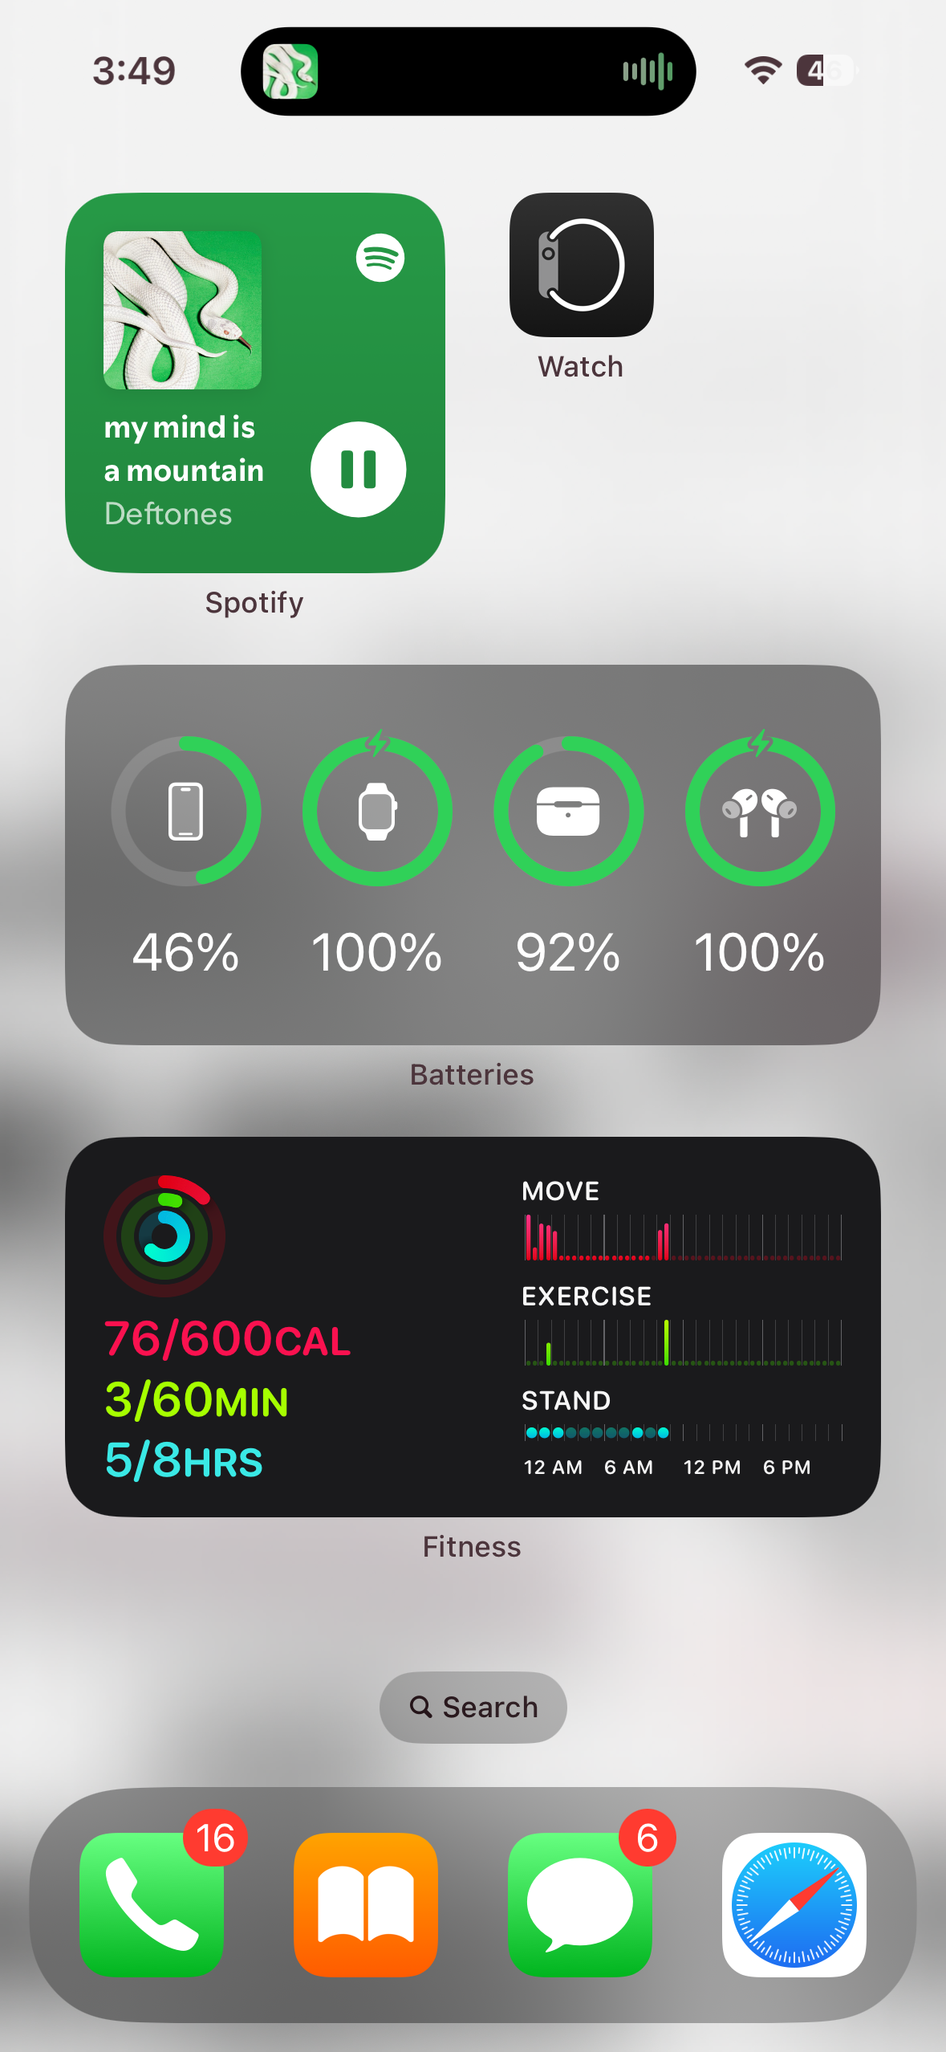
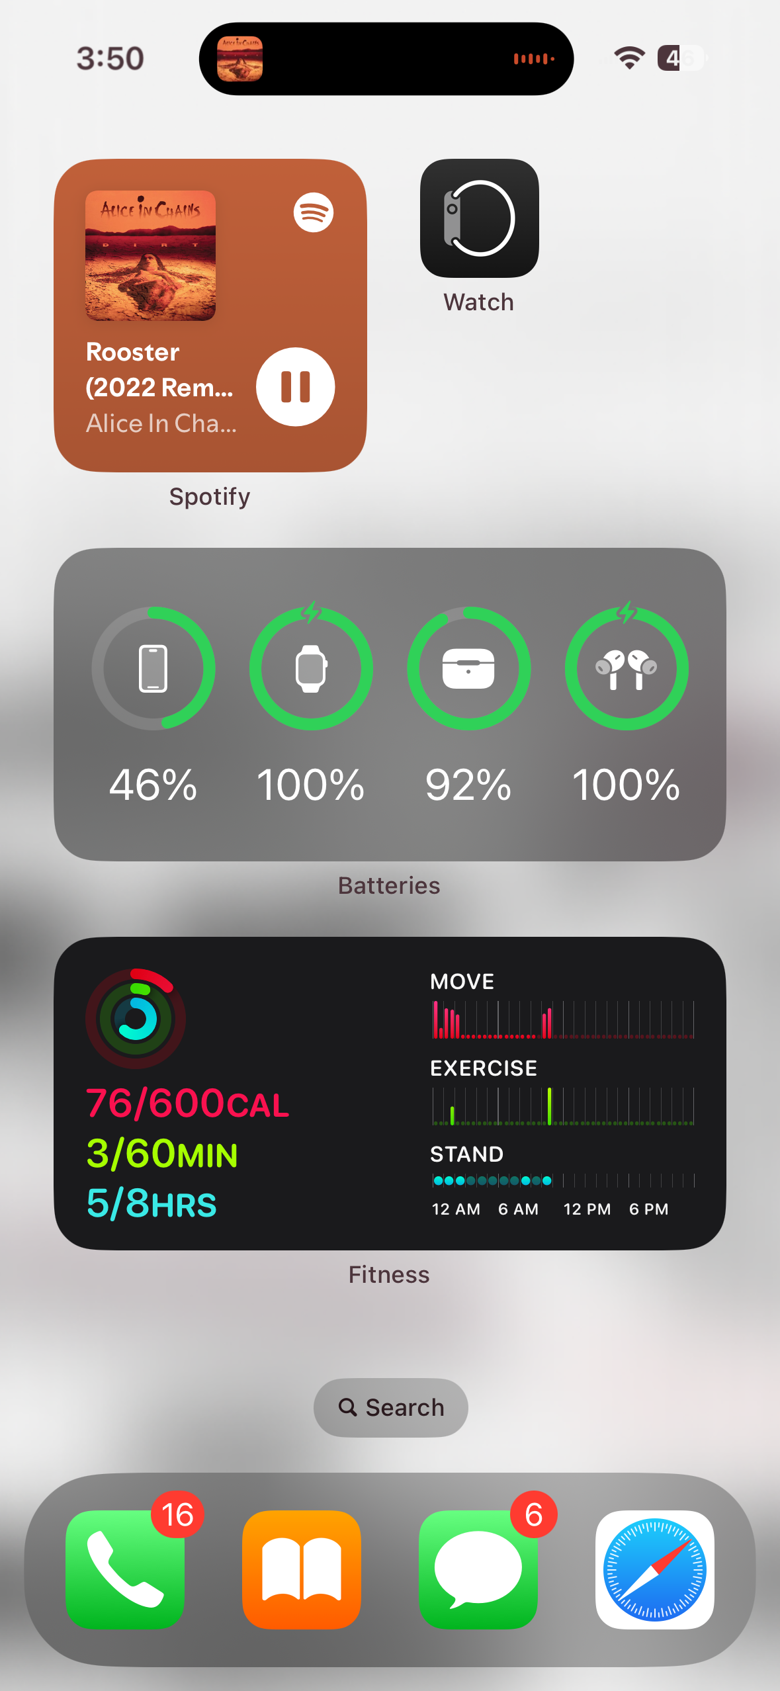
Spotify
Social Media Analysis
Hannah Wilkinson
IMC – 541 – 900
Week 3 Writing Assignment
Professor Neal Stewart
September 8, 2025

Slide 3

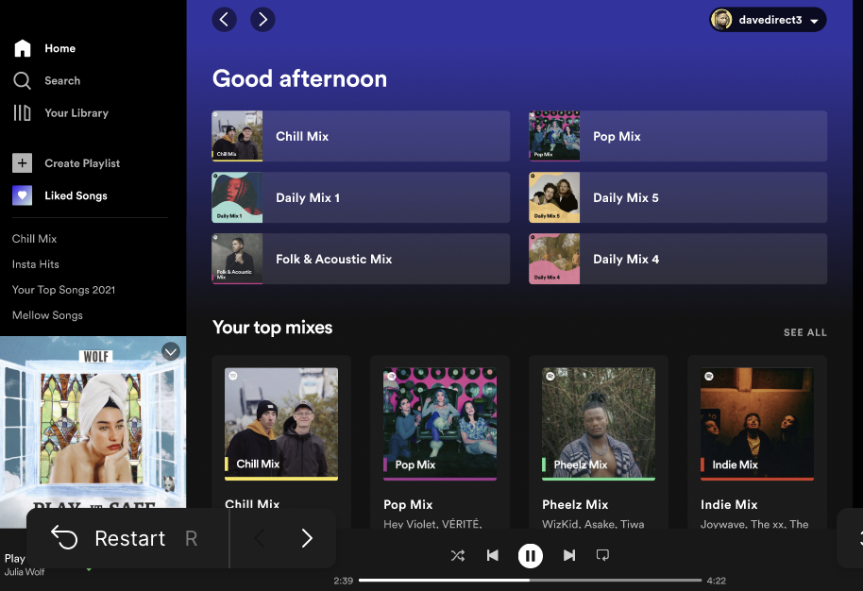
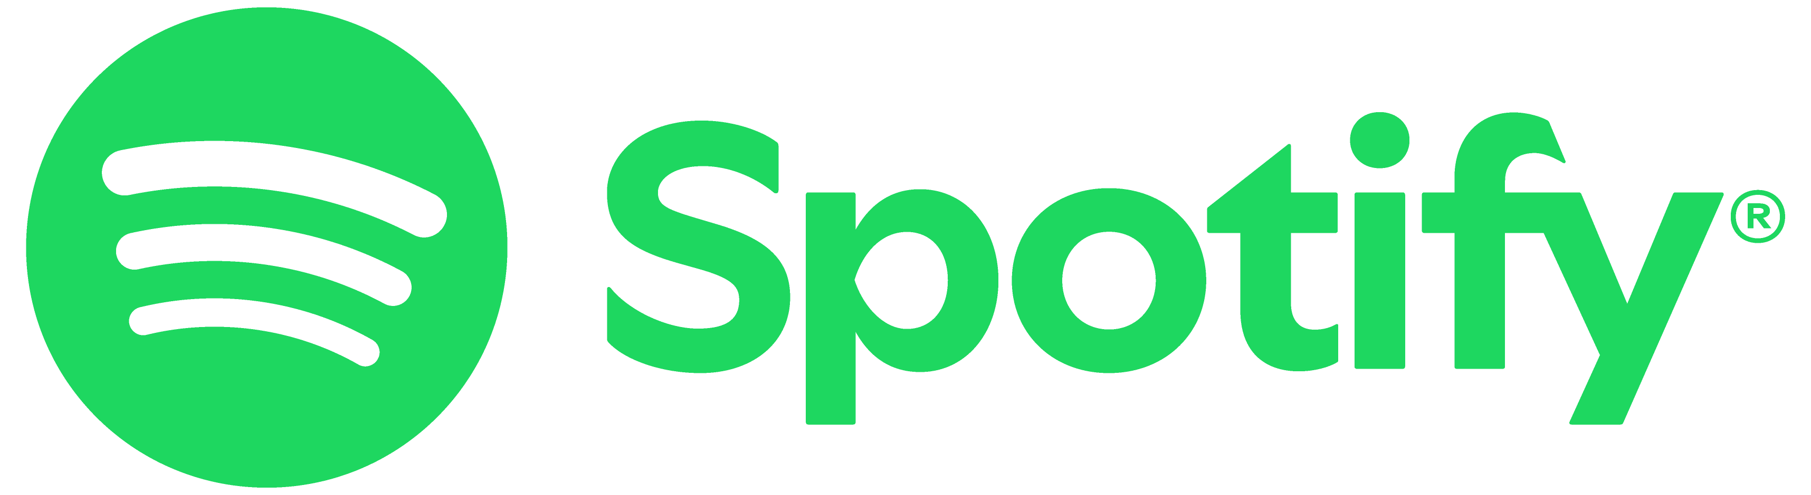
Although Spotify continually takes the lead in the music streaming industry, it is also just as important that Spotify adapts and develops a strong social media presence to hold that place. Spotify lacks in some areas of engagement and innovation which can help create a bigger presence.
By incorporating strategic keywords, measuring campaign analytics, and adding new ideas, Spotify can keep working to take the lead in the social media realm.
Introduction
Notes:
Brand, context, purpose

Slide 4
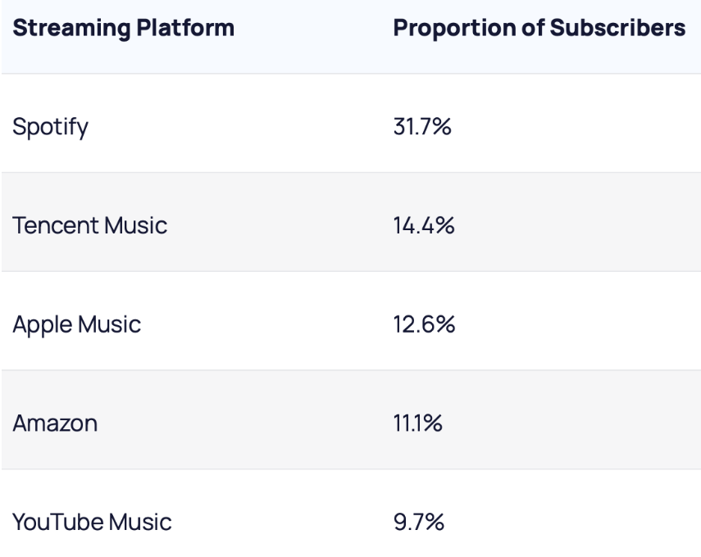


Competitors
Apple Music
Created in 2015, Apple Music began as a popular music streaming service with purchasing individual songs. This is the largest relevant competitor to Spotify.
Amazon Music
Originating in 2008, Amazon Music began selling MP3 music online. Amazon offers lower-tiered membership of Amazon Music with an Amazon Prime subscription.
Both Apple Music and Amazon Music have an advantage with established customer bases and credibility with customers.
Notes:
https://www.instagram.com/applemusic/

Slide 5
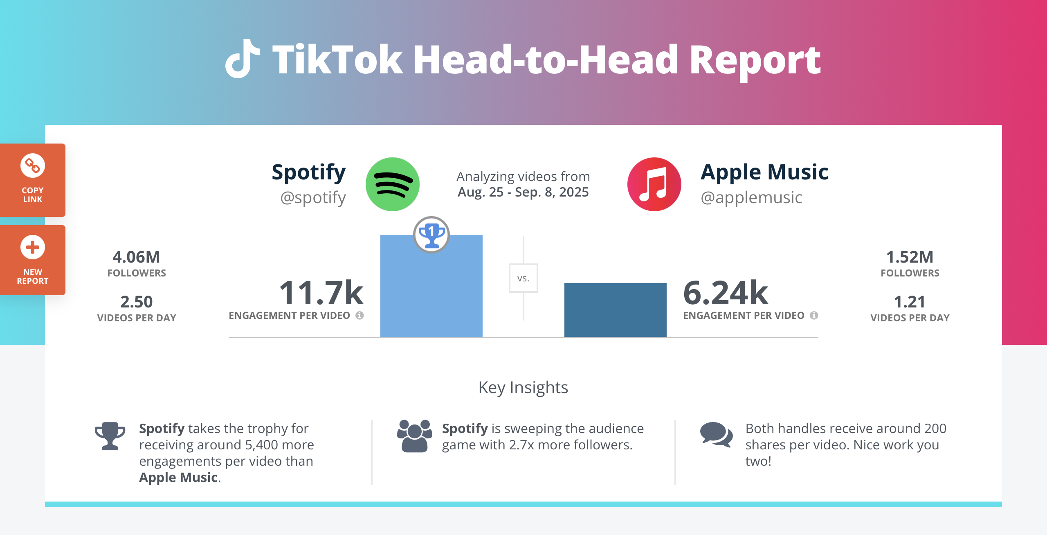
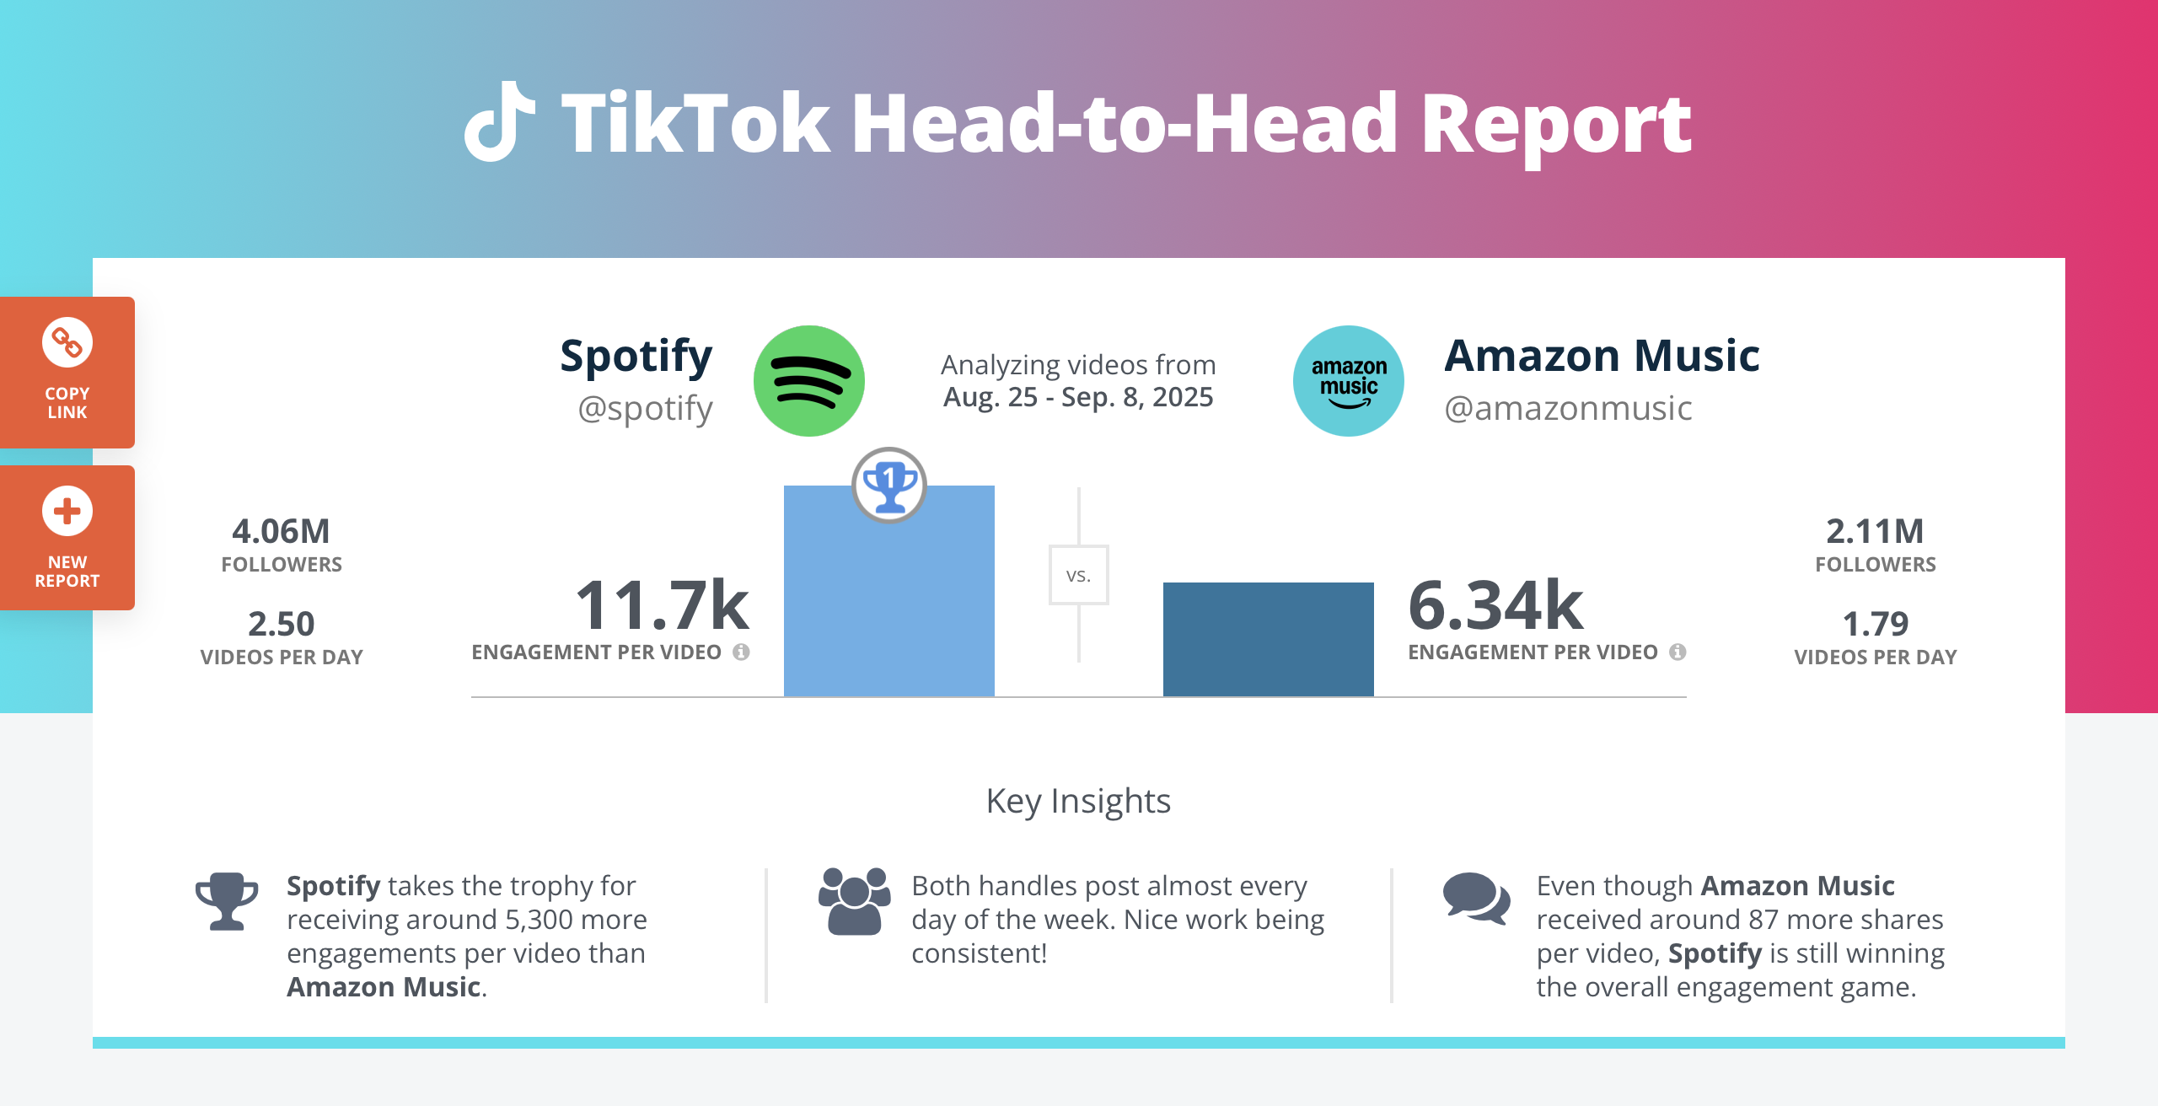
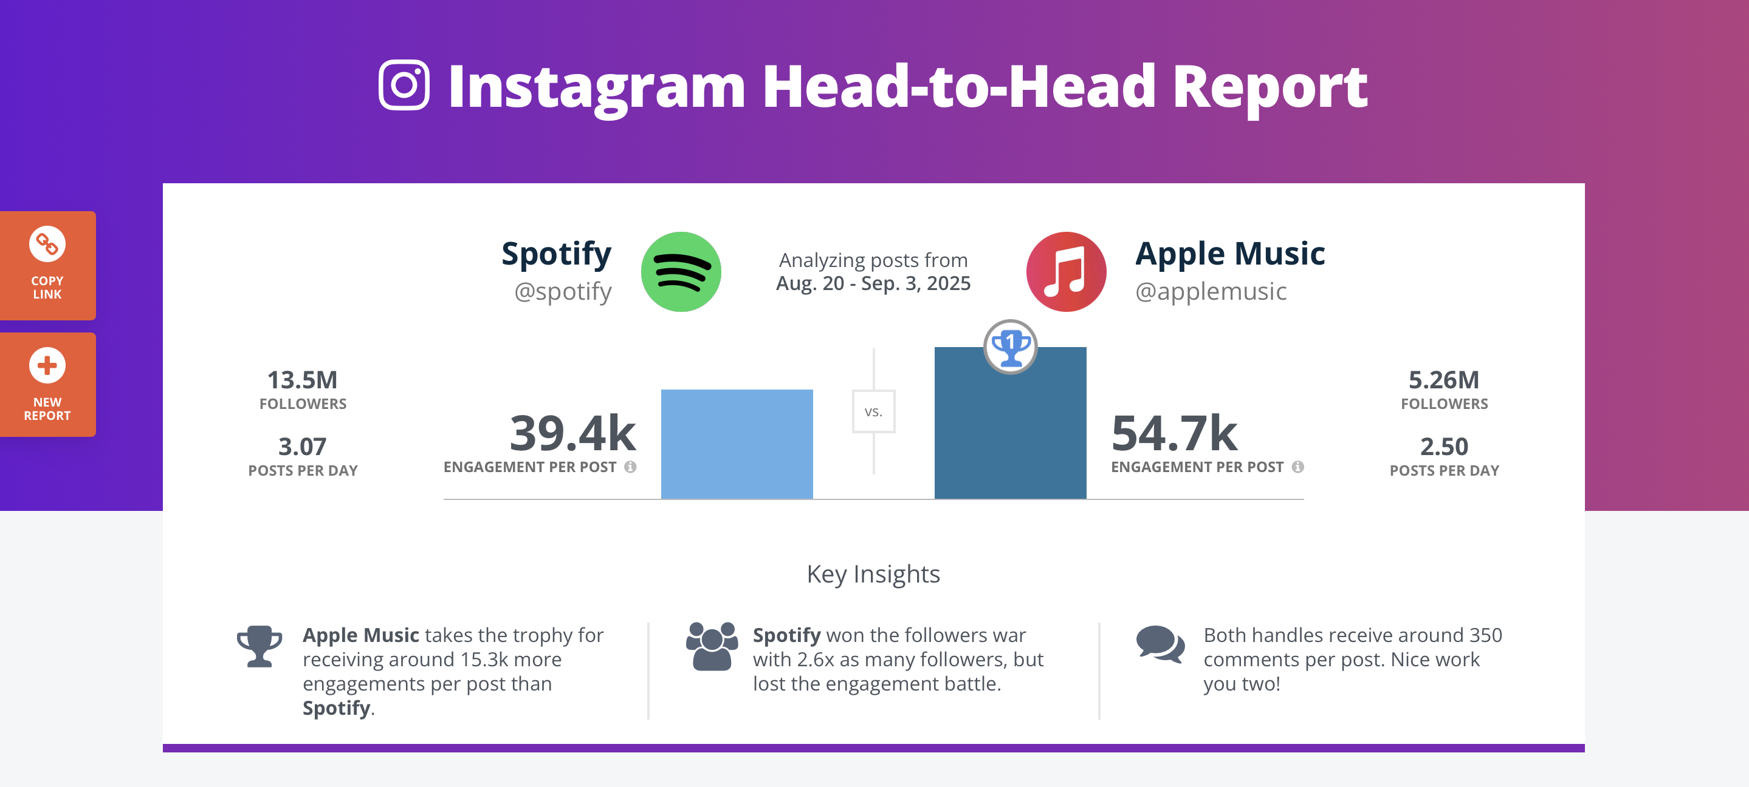
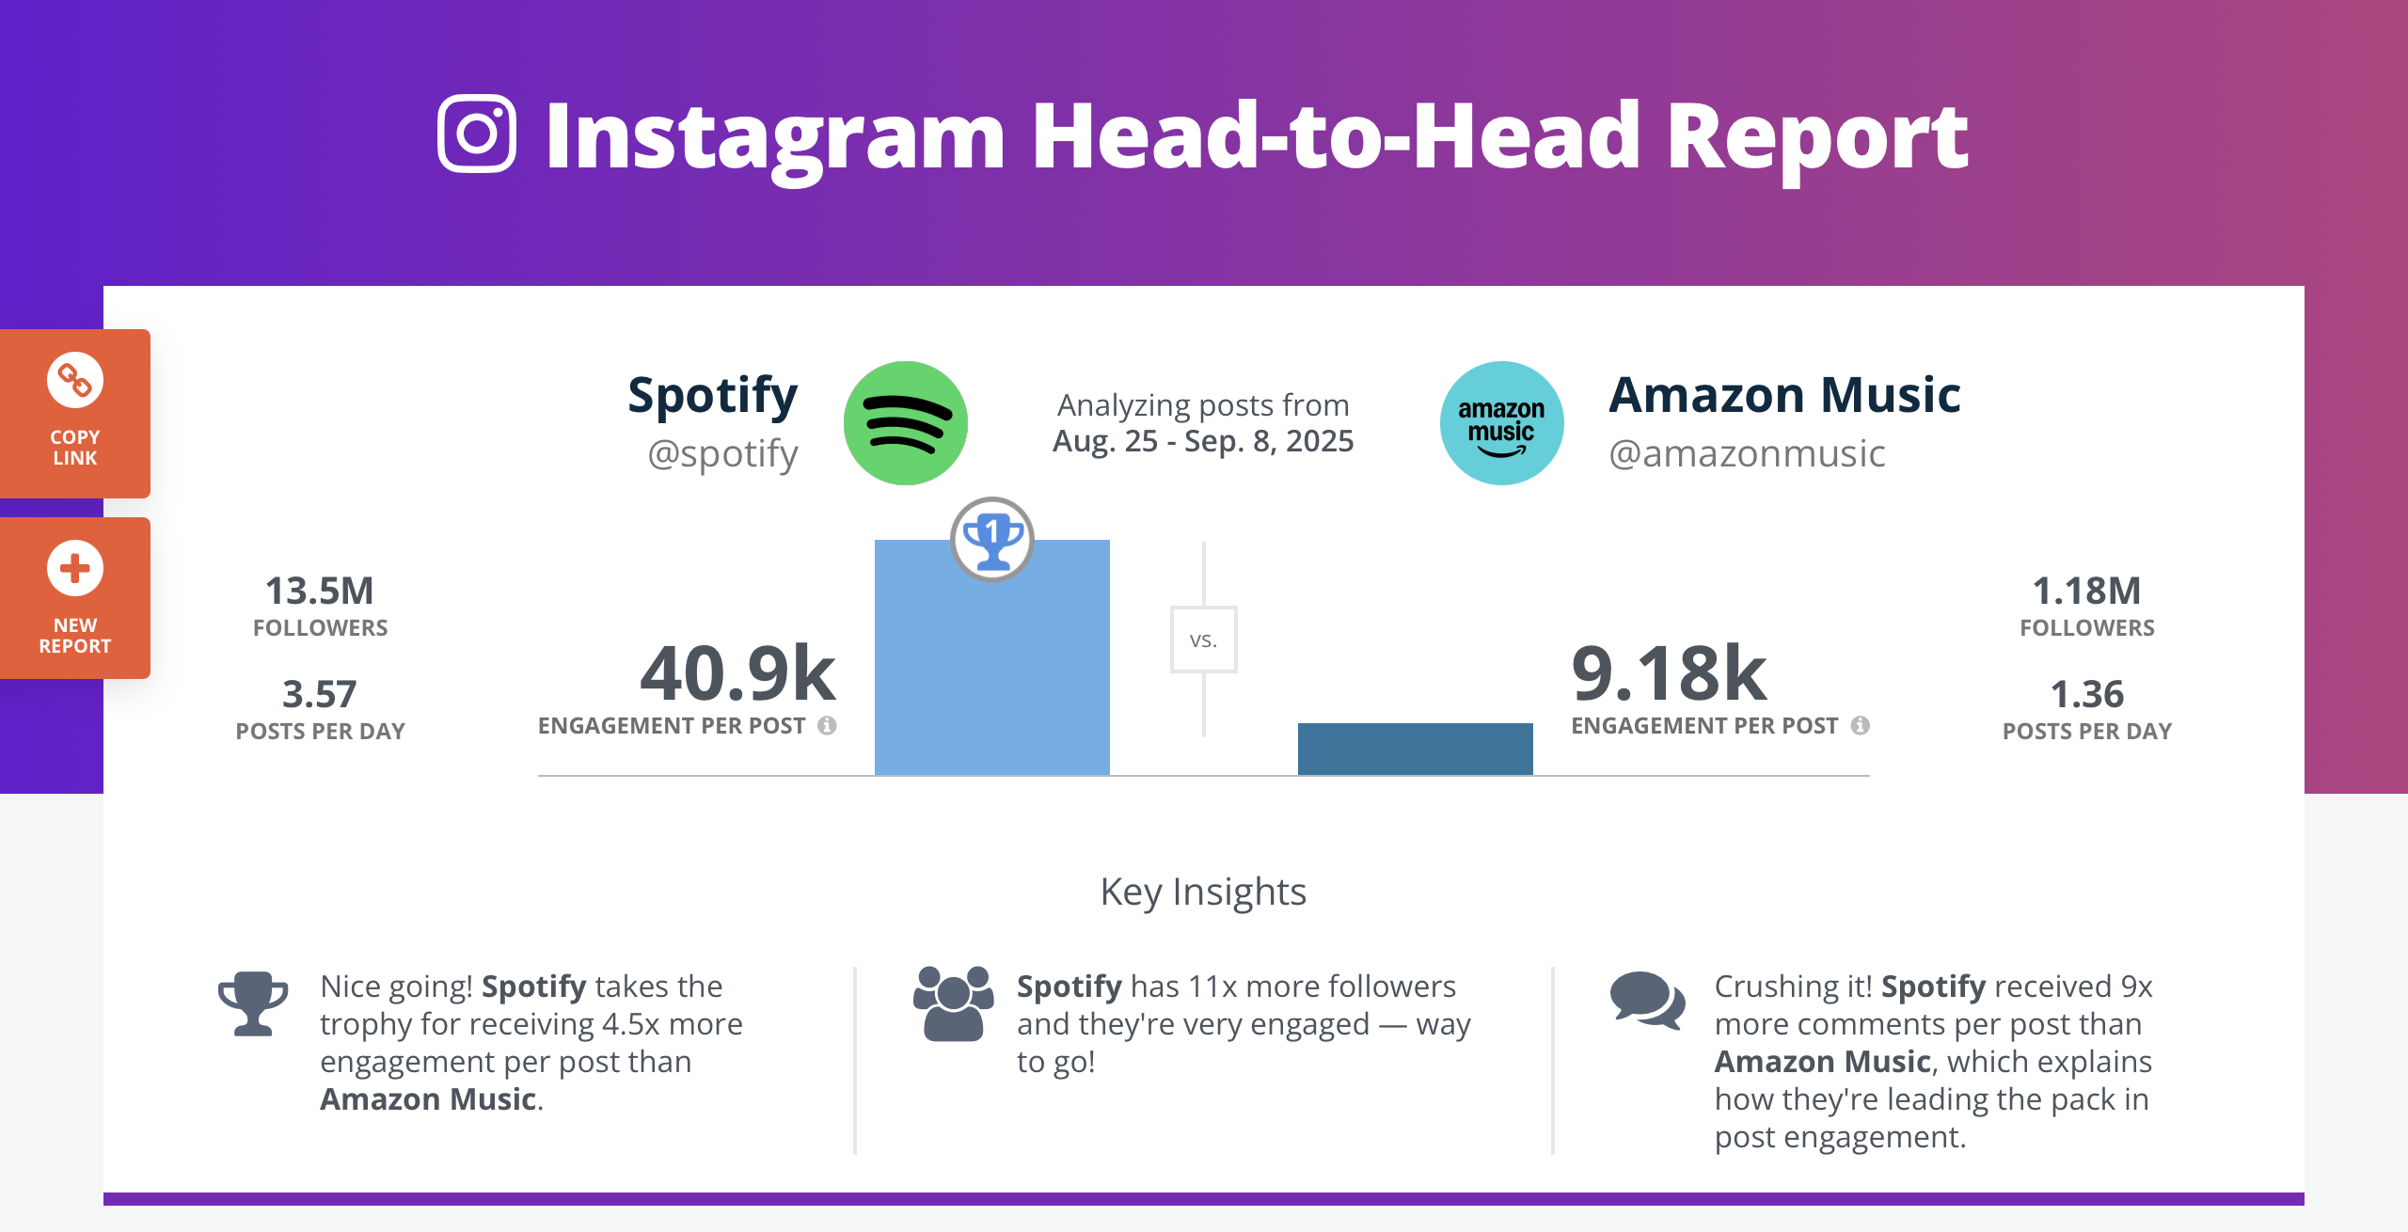
Social Media Audit
TikTok
Analysis Range:
August 20 – September 8, 2025
Report 1. Rival IQ. (2022, May 3). https://www.rivaliq.com/free-social-media-analytics/report/#reports-tiktok-g0a3E7cAFc22
Report 2. Rival IQ. (2022a, May 3). https://www.rivaliq.com/free-social-media-analytics/report/#reports-tiktok-gfB2803c3D9D
Instagram
Report 3. Rival IQ. (2022a, May 3). https://www.rivaliq.com/free-social-media-analytics/report/#reports-instagram-gbc7A2372493
Report 4. Rival IQ. (2022a, May 3). https://www.rivaliq.com/free-social-media-analytics/report/#reports-instagram-gBE8c22cDFF4
Notes:
Use RivalIQ
TikTok: Spotify vs Apple Music
https://www.rivaliq.com/free-social-media-analytics/report/#reports-tiktok-g0a3E7cAFc22
TikTok: Spotify vs Amazon
https://www.rivaliq.com/free-social-media-analytics/report/#reports-tiktok-gfB2803c3D9D

Slide 6

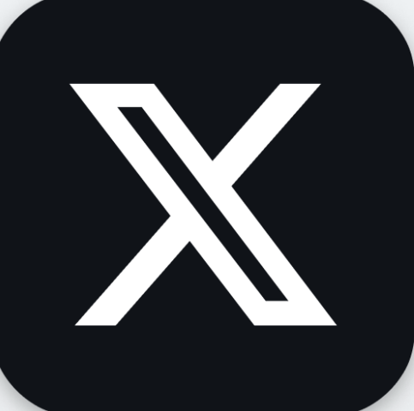


Social Media Audit
Spotify’s Social Media Statistics
23M
Facebook Followers
19.2M
X (Formerly Twitter) Followers
13.4M
Instagram Followers
4.1M
TikTok Followers
Notes:
Use RivalIQ

Slide 7
Social Media Audit
 | Spotify | Apple Music | Amazon Music
Platforms & Handles | Facebook: https://www.facebook.com/spotifyusa/?brand_redir=6243987495, X, Instagram: https://www.instagram.com/spotify/, TikTok | Instagram: https://www.instagram.com/applemusic/
Cadence (avg posts/week for last 30 days)
Engagement Rate Per Post (interactions / followers)
Top 3 Posts
Creator/UGC
Paid Signals
Community Care
Content Pillars | Entertaining

Slide 8
Spotify Social Media Audit
Who | Where | What | When | Why
Spotify
Consumer
Competitor

Slide 9
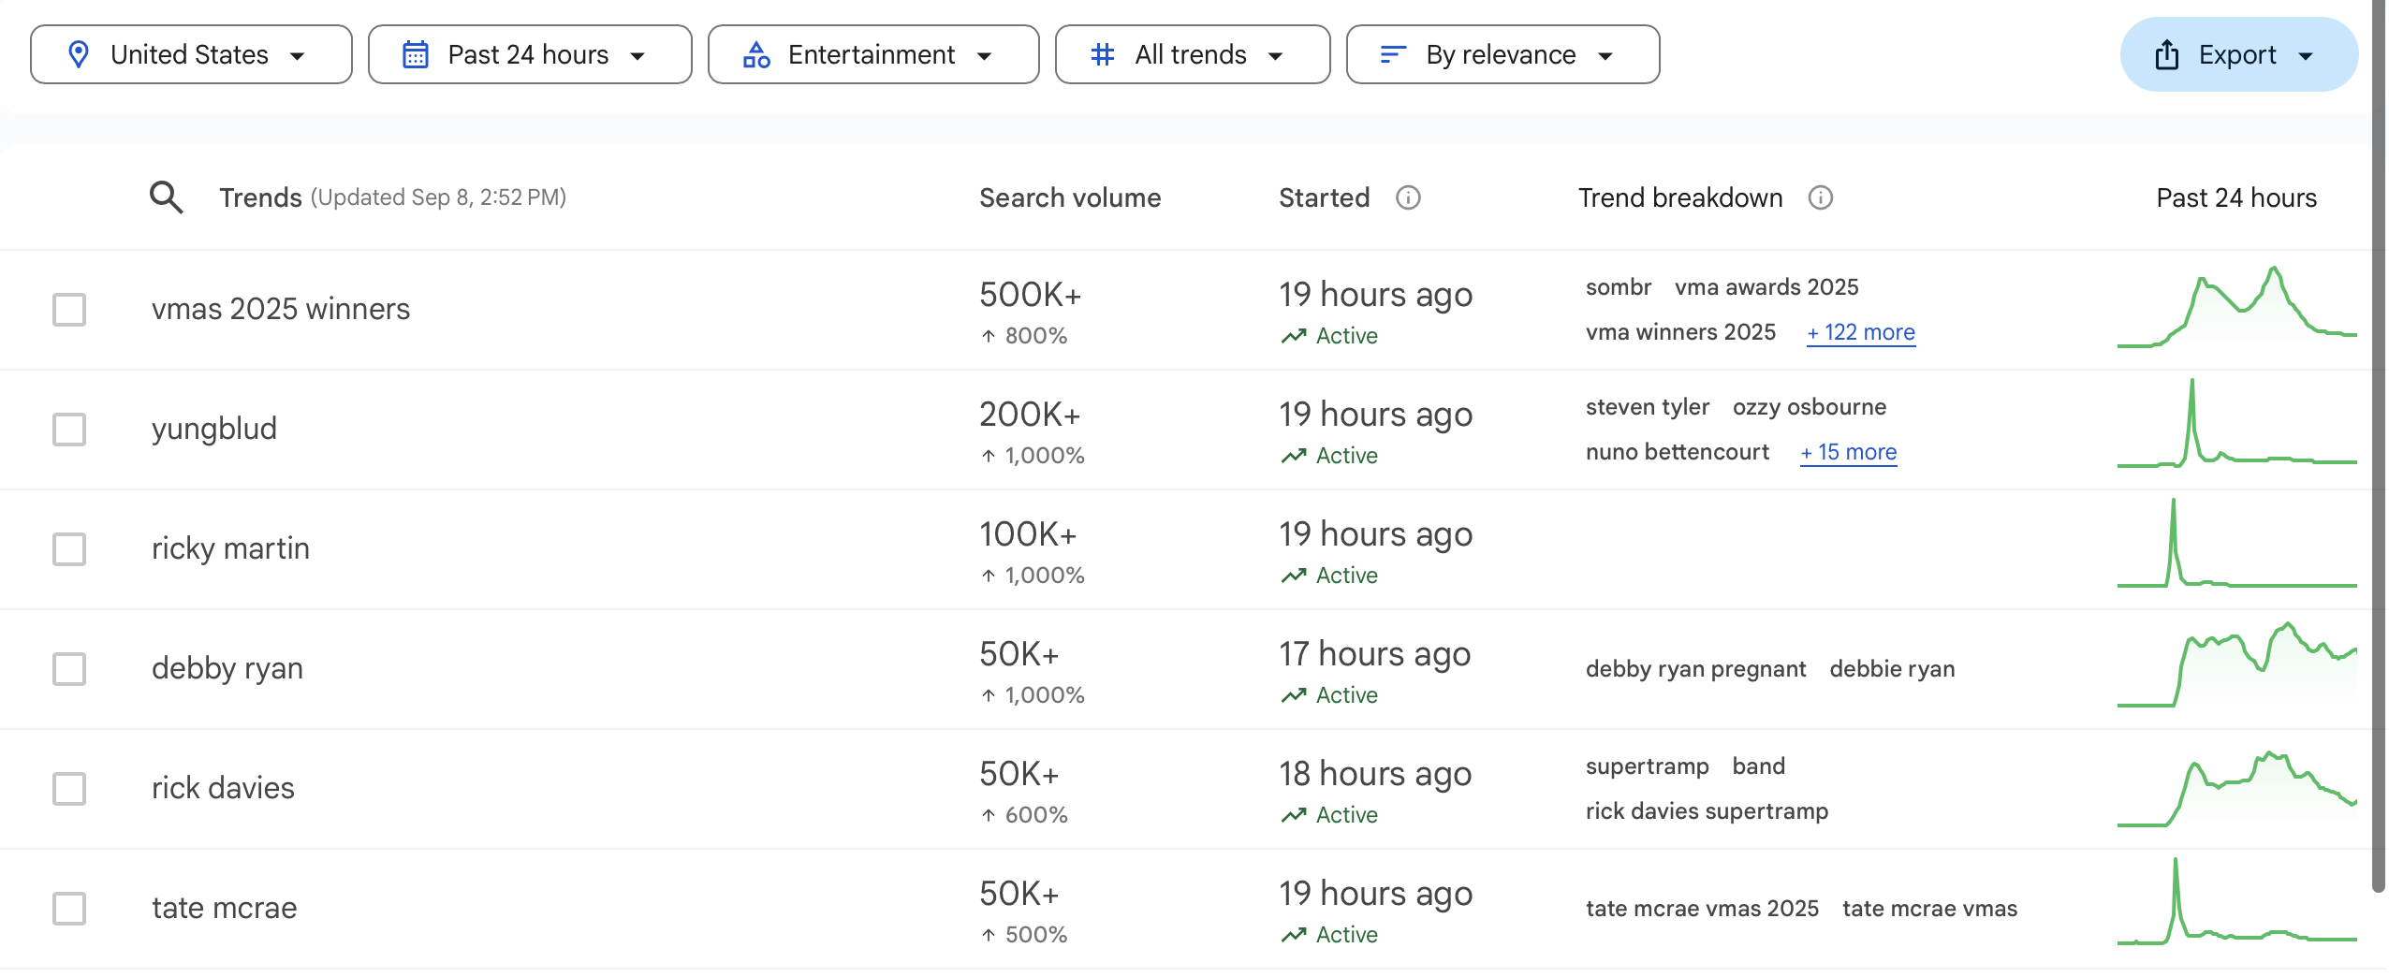
Keyword List
Brand Keywords
Relevant Trending Keywords:
VMAs 2025 Winners
Ricky Martin
Yungblud
Tate McRae
These keywords and hashtags will help reach the desired target audience and help to track campaign performance.
Hashtags
Event-Related: #VMAs (MTV Video Music Awards), #Coachella, #Lollapalooza, #AMAs (American Music Awards)
Campaigns: #SpotifyWrapped
Google. (n.d.). Trending now. Google Trends. https://trends.google.com/trending?geo=US&hl=en-US&category=4
Notes:
These keywords will help to measure UGC and have a community of content created to easily see. Partner with influencers to use a shared hashtag like “#SpotifyStories”
Google. (n.d.). Trending now. Google Trends. https://trends.google.com/trending?geo=US&hl=en-US&category=4

Slide 10
Key Insights
Spotify has a higher following on Instagram than Apple Music but still receives a lower engagement rate per post. Apple Music receives about 15.3k more in engagement per post.
Surprisingly enough, Amazon Music receives a higher engagement rate than Apple Music on TikTok, despite more followers.
Notes:
What the data means + what to do
What is working, what is not working

Slide 11
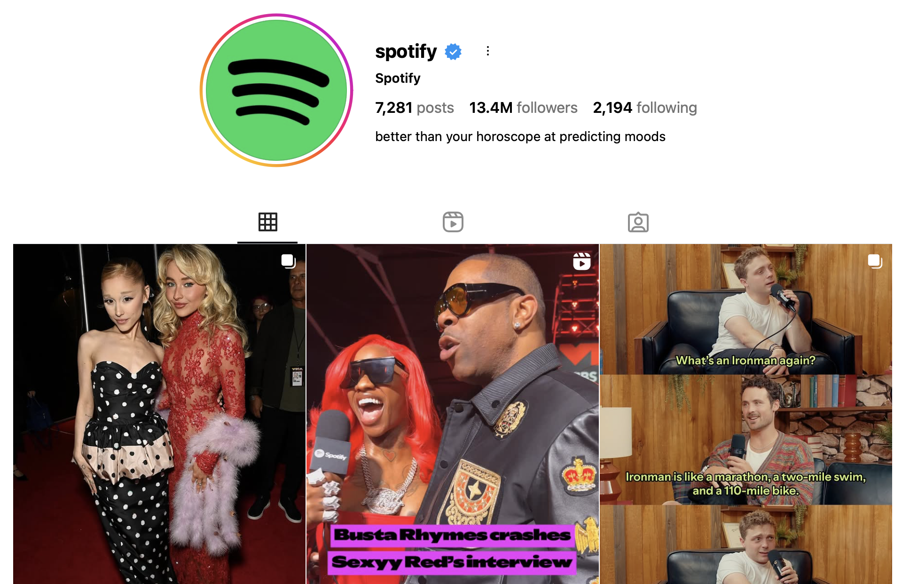
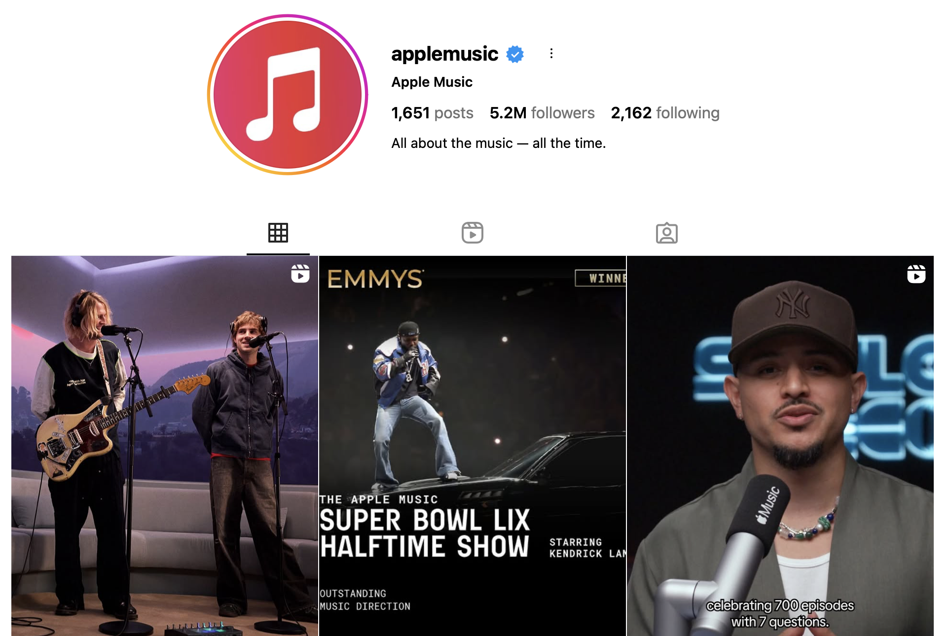

Key Insights – Ideas for Social Strategies
Migrate away from graphics and turn towards more video content, like what Apple Music is doing
Notes:
Add Instagram story highlights?

Slide 12
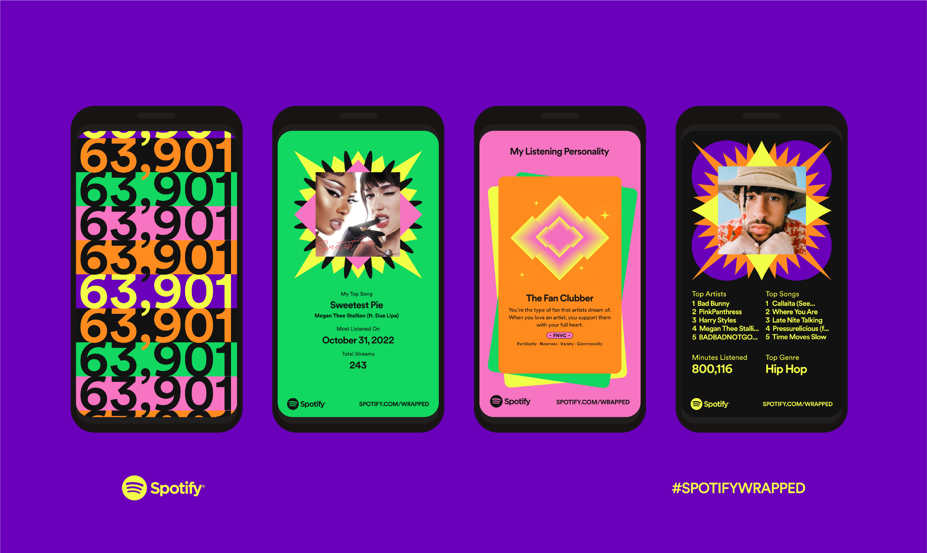
Key Insights – Ideas for Social Strategies
Launch a campaign ”Who’s Your Favorite Artist’s Favorite Artist?”
This alludes to the already popular Spotify Wrapped campaign
This can also be in video content form
This will engage with popular artists
This will showcase how artists are using Spotify
Notes:
Add Instagram story highlights?
Campaign for artists to talk about their Spotify Wrapped: Who’s Your Favorite Artist’s Favorite Artist?

Slide 13
Key Insights – Ideas for Social Strategies
Create a Spotify Character
Duolingo is a popular app that is using the power of a character to increase brand awareness.
Notes:
Add Instagram story highlights?
Campaign for artists to talk about their Spotify Wrapped: Who’s Your Favorite Artist’s Favorite Artist?
Using trending audio for TikTok videos

Slide 14
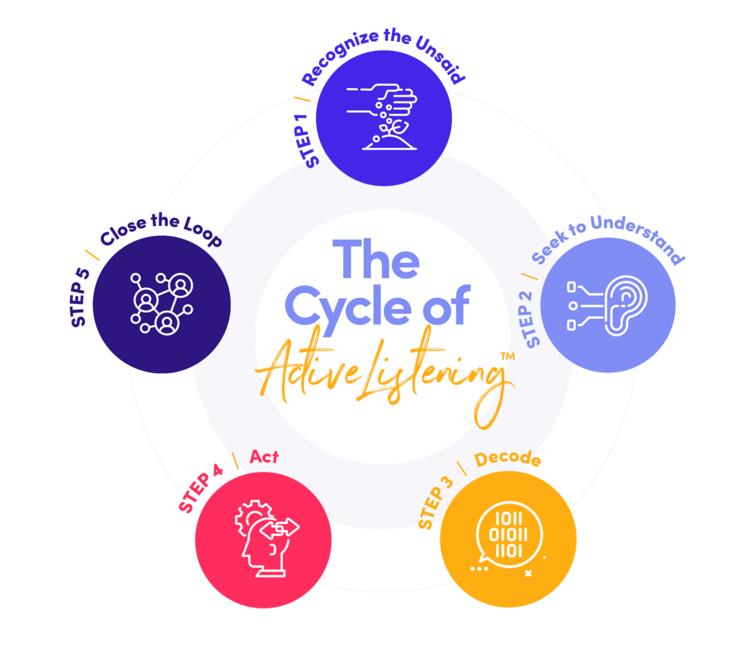
Listening Action Loop
The content created will be tracked using keywords and analytics. It will then be easier to track which campaigns and content is performing best. Once determined, adapting the content will be done.
Notes:
How you will keep monitoring and adjust next steps

Slide 15
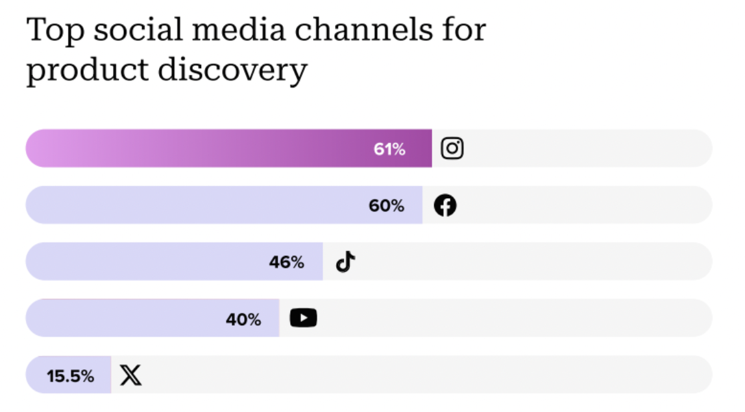
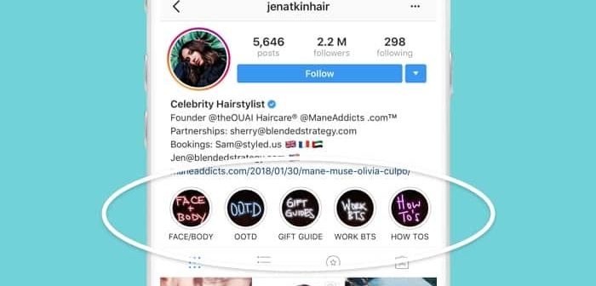
Business Objectives
Given that Instagram is the top social media channel for product discovery, at 61%, it is important to maximize reach here (SproutSocial, 2025).
Increase Instagram engagement rate per post from 39.4k to 43.k by September 30th by posting more video content.
Increase Instagram engagement for specific campaigns by utilizing Instagram Story highlights.
Zote, J. (2025, June 20). 26 Instagram stats you need to know for 2025. Sprout Social. https://sproutsocial.com/insights/instagram-stats/
Notes:
SMART Guidelines
Business outcomes
2- 4 objectives
I.e. “Increase IG ER/post from 0.9% to 1.2% in 60 days by adding 3 creator reels/week + spark ads.”

Slide 16



Conclusion
By implementing new ideas, strategic keywords, and monitoring social media and competitors, Spotify can ensure a compelling social media presence. Measuring performance of content and adapting will continually strengthen the efforts.
Notes:
Paragraph summing up what was learned and presented.

Slide 17
References
Report 1. Rival IQ. (2022, May 3). https://www.rivaliq.com/free-social-media-analytics/report/#reports-tiktok-g0a3E7cAFc22
Report 2. Rival IQ. (2022a, May 3). https://www.rivaliq.com/free-social-media-analytics/report/#reports-tiktok-gfB2803c3D9D
Report 3. Rival IQ. (2022a, May 3). https://www.rivaliq.com/free-social-media-analytics/report/#reports-instagram-gbc7A2372493
Report 4. Rival IQ. (2022a, May 3). https://www.rivaliq.com/free-social-media-analytics/report/#reports-instagram-gBE8c22cDFF4
Quesenberry, K. (2024, January 22). Social media not giving what you want? you need a social media audit. Post Control Marketing. https://www.postcontrolmarketing.com/social-media-audit/
Zote, J. (2025, June 20). 26 Instagram stats you need to know for 2025. Sprout Social. https://sproutsocial.com/insights/instagram-stats/
Notes:
https://www.rivaliq.com/free-social-media-analytics/report/#reports-instagram-gbc7A2372493
https://www.instagram.com/applemusic/?hl=en
https://www.facebook.com/spotifyusa/?brand_redir=6243987495
https://x.com/Spotify?ref_src=twsrc%5Egoogle%7Ctwcamp%5Eserp%7Ctwgr%5Eauthor

